Slide 1
Health Monitoring and Optimization
Notes:
This module explores common techniques used to monitor SharePoint 2010 farms and to optimize their performance. You will learn how to troubleshoot problems using the Developer Dashboard and how to read diagnostic information from ULS logs and the Logging Database. The module also discusses using the new Health Analyzer and configuring Usage Reporting.

Slide 2
Agenda
The Developer Dashboard
Understanding ULS Logs
The Logging Database
Health Analyzer and Usage Reporting
Timer Jobs ad Server Affinity
Usage Reporting
SQL Server Considerations

Slide 3
Developer Dashboard
What is it?
Dashboard that displayed detailed information about the page load.
What does it do for me?
Helps monitor page load & performance
Helps troubleshoot performance issues and pinpoint specific items that are causing slow page loads.

Slide 4
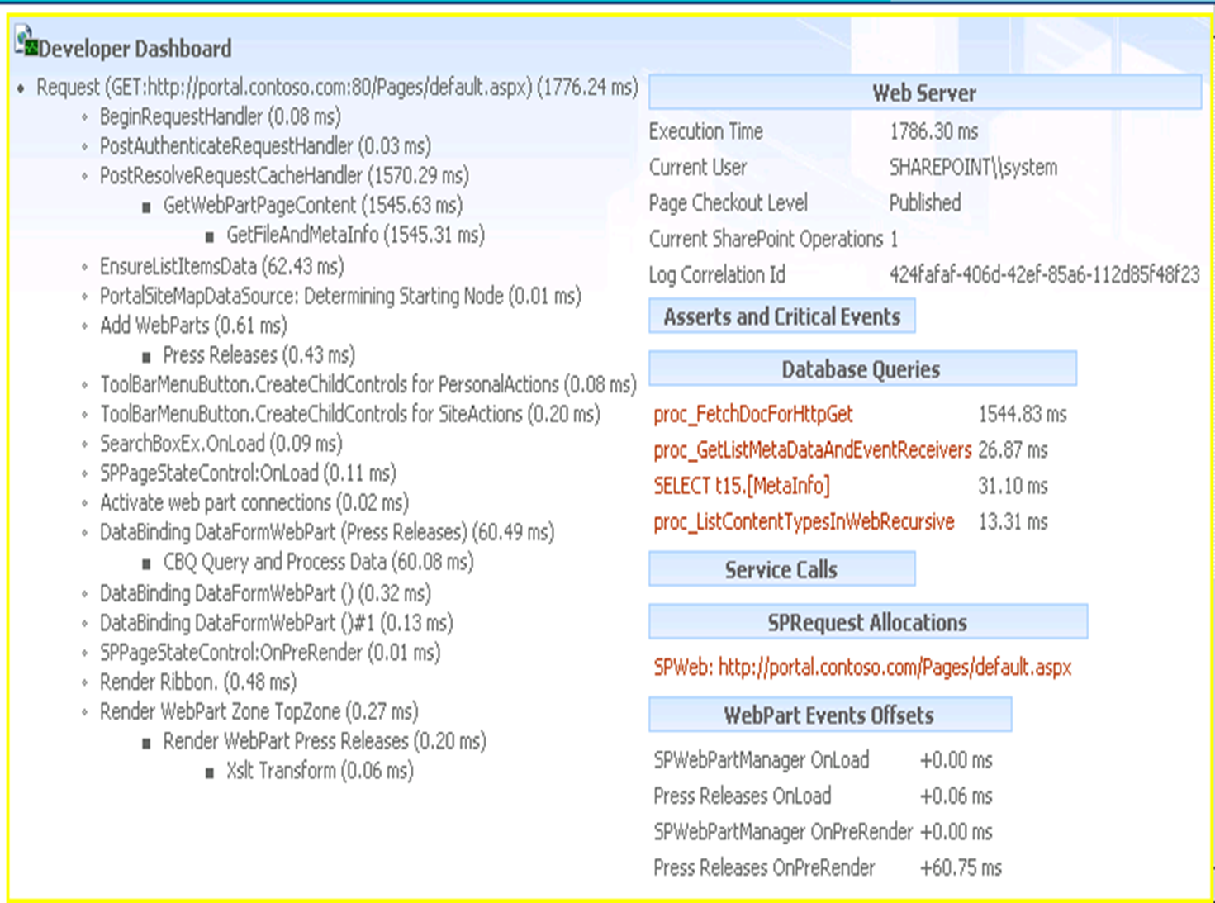
Developer Dashboard
Notes:
There are other tools out on the market that have been around since the last version that provide you with this insight.. On in particular is Idera’s SharePoint Performance Manager 2.0 which was at one point called Sonar.
The one nice thing about the Developer Dashboard is that it is invisible to the user. Only the Site Collection Admin will see this tool once it is enabled.

Slide 5
Developer Dashboard
Information contained on the dashboard:
Times to render various components on page
Page Checkout level
Database query information
Web part processing time
Any critical events or alerts

Slide 6
DEMO
Using the Developer Dashboard

Slide 7
Agenda
The Developer Dashboard
Understanding ULS Logs
The Logging Database
Health Analyzer and Usage Reporting
Timer Jobs ad Server Affinity
Usage Reporting
SQL Server Considerations

Slide 8
ULS Logs
What is ULS?
ULS = Unified Logging Service
Collects information from the farm and server
Logs stored in \14\LOGS folder
Logs are 50% smaller now with NTFS compression
What information does it collect?
Event logs
Application logs
3rd party applications can be integrated into logs

Slide 9
ULS Logs
Correlation ID
New column added to SharePoint 2010 logs
GUID assigned to every task and event that takes place
Extremely helpful when troubleshooting errors
PowerShell can be used to trace Correlation IDs
Event Log Flood Protection
Keeps logs clean and uncluttered
Stops recording events when they begin repeating
Resumes recording when conditions return to normal

Slide 10
ULS Logs
More about ULS logs…
Compression is enabled by default
Less “noise” in the log files to make it easier to browse
Event log flood protection helps control number of events logged
Log size quotas can be configured to cap growth

Slide 11
SharePoint ULS Log Viewer
CodePlex Tool
http://ulsviewer.codeplex.com/
Safe to use
Makes reading and filtering of logs much easier
Free!!
Notes:
Can be used in production troubleshooting as it only reads logs. It does not affect system
One of the tool of choices for Microsoft Support when looking for problems.

Slide 12
Event Log Flood Protection Configuration
Configuration Settings
Setting | Description | Unit | Default
Threshold | The number of events allowed in a given timeframe (TriggerPeriod) until this event is considered to be flooding the log. | Integer. Value must be between 0 (disabled) and 100 (maximum threshold) | 5
TriggerPeriod | The timeframe to monitor for each event that potentially floods the log. | Seconds | 120
QuietPeriod | How much time should pass without the event firing to cancel the flooding mode. | Seconds | 120
NotifyPeriod | If the event is flooding the log for a long time, this setting forces the suppressed notification event to be fired even if the flooding is still occurring. | Seconds | 300

Slide 13
DEMO
Reading ULS Logs

Slide 14
Agenda
The Developer Dashboard
Understanding ULS Logs
The Logging Database
Health Analyzer and Usage Reporting
Timer Jobs ad Server Affinity
Usage Reporting
SQL Server Considerations

Slide 15
The Logging Database
Specialized SQL Database
“WSS_Logging”
Repository for all SharePoint-related events from across farm
ULS Logs, Performance Logs, Usage Logs
Used by the Usage Logging Service
Public schema
Database can be edited!
Administrators and DBAs can write reports directly from database
3rd parties can write log info to it also

Slide 16
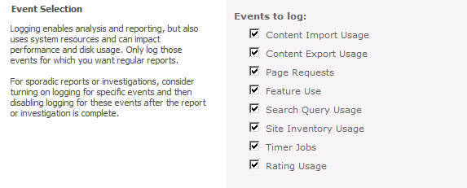
The Logging Database
Configurable
What it collects is configured in Central Administration
Can also be configured to collect Health Report data
Plan for performance and capacity!
Logging = lots of disk space used
Logging = lots of SQL activity

Slide 17
The Logging Database
The logging database is a hoarder. It collects all kinds of information:
SQL Logging Database
Feature use | Page Requests
Search Queries | Site Inventory Usage
Timer Jobs | Rating Usage
Content Import Usage | Content Export Usage
Server Farm Health Data | NT Events
SQL blocked queries | SQL high CPU/ IO queries
Site Inventory | Search Crawl
Search Query statistics | Query click-through
Users’ ratings | …and more
Notes:
Feature use
Page Requests
Search Queries
Site Inventory Usage
Timer Jobs
Rating Usage
Content Import Usage
Content Export Usage
Server Farm Health data
...and more

Slide 18
Agenda
The Developer Dashboard
Understanding ULS Logs
The Logging Database
Health Analyzer and Usage Reporting
Timer Jobs ad Server Affinity
Usage Reporting
SQL Server Considerations

Slide 19
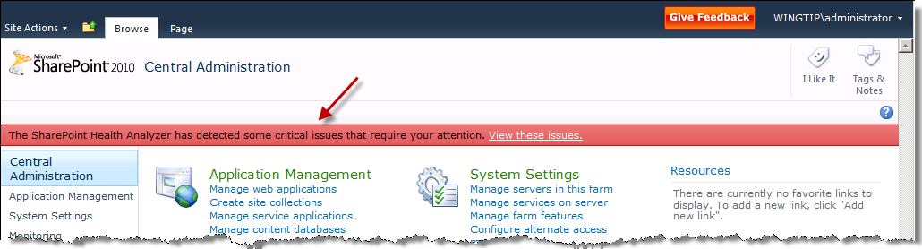
Health Analyzer
What is it?
Rule-based system for “best practices”
Runs timer jobs to compare farm settings to the rules
Why do I want it?
It is helpful – displays message on home page when issues are discovered
Notes:
The Health Analyzer is somewhat similar to what we had in previous versions with the BPA tool The only exception was that previously we had to load and run the tool from the each server and now this tool is built into the product and runs via a timer job.

Slide 20
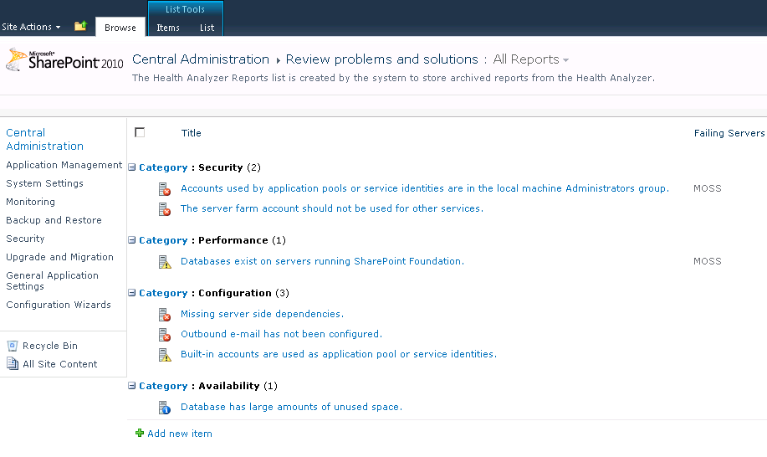
Health Analyzer

Slide 21
DEMO
Health Analyzer

Slide 22
Agenda
The Developer Dashboard
Understanding ULS Logs
The Logging Database
Health Analyzer and Usage Reporting
Timer Jobs ad Server Affinity
Usage Reporting
SQL Server Considerations

Slide 23
Timer Jobs
Server Affinity
Choosing which SharePoint server runs the Timer Jobs for a particular content database.
You can pick one (or more) servers and saddle them with the load of running Timer Job’s
Or if you're troubleshooting a timer job you can isolate it to one server for easier troubleshooting.

Slide 24
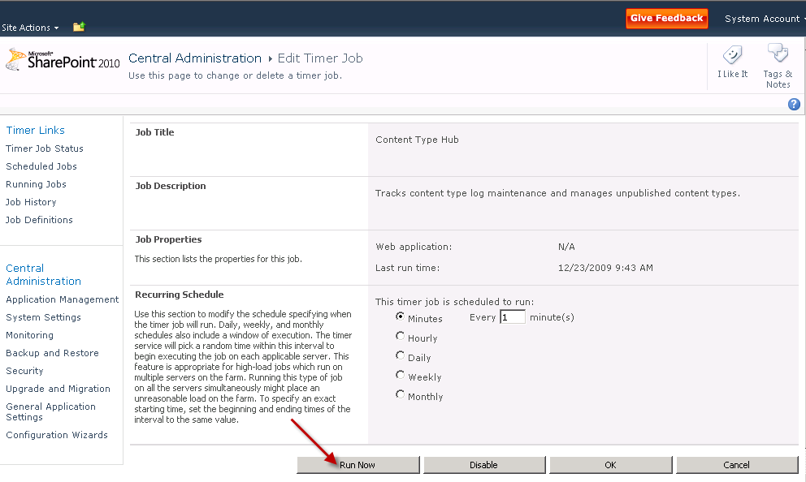
Timer Jobs
Ability to Run Timer Jobs On Demand

Slide 25
DEMO
Timer Jobs

Slide 26
Agenda
The Developer Dashboard
Understanding ULS Logs
The Logging Database
Health Analyzer and Usage Reporting
Timer Jobs ad Server Affinity
Usage Reporting
SQL Server Considerations

Slide 27
Usage Reporting
SQL Logging Database
Write reports to pull data from SQL
Web Analytics Service
Provides information to admins and users about usage
More reports available than with SharePoint 2007
Can filter reports

Slide 28
Usage Reporting
Information available in Site Collection reports include…
Total Number of Page Views
Average Number of Page Views/day
Total Number of Daily Unique Visitors
Average Number of Unique Visitors/day
Total number of Referrers
Average Number of Referrers per Day
Total Number of Search Queries
Total Number of Sites
Total Number of Lists
Total Storage Used
…and more

Slide 29
Usage Reporting
Information available in Site reports include…
Total Number of Page Views
Average Number of Page Views/day
Total Number of Daily Unique Visitors
Average Number of Unique Visitors/day
Total number of Referrers
Average Number of Referrers per Day
Total Number of Sites
Total Number of Lists
Total Storage Used
…and more (similar to Site Collection without Search stats)

Slide 30
Agenda
The Developer Dashboard
Understanding ULS Logs
The Logging Database
Health Analyzer and Usage Reporting
Timer Jobs ad Server Affinity
Usage Reporting
SQL Server Considerations

Slide 31
SQL? I’m a SharePoint admin!
Foundation & SharePoint Server
Farm configuration is stored in SQL.
All SharePoint content is stored in SQL, unless using RBS
Central Admin is a web application and is in its own content database
Service Applications have databases as well
Search
Taxonomy, etc
Notes:
Needs Analysis Services database as well to store OLAP cubes

Slide 32
Standard or Enterprise?
Standard features
Supports up to 4 CPUs (including cores)
Supports OS Maximum RAM, 4 GB of RAM on 32 bit OS
Failover is manual and restricted to two nodes
Supports Database Mirroring
Native 64 bit support
Notes:
Three types of mirrors;
High Availability – Requires witness – Automatic - Safe
High Protection – No witness – manual - Safe
High Performance – No witness – forced – unsafe
Standard cannot do high performance

Slide 33
Movin’ on up…Enterprise
Full SQL 2005 or 2008 functionality
Supports more than 4 CPUs
Support for up to 32 GB of RAM on 32 bit OS, OS limitation, not SQL’s
Active failover for mirrors
KPI and Analysis Server built in
Comparison chart of all the versions at
http://www.microsoft.com/sqlserver/2008/en/us/editions-compare.aspx
http://www.microsoft.com/sql/prodinfo/features/compare-features.mspx

Slide 34
Keep your SQL Server Box Happy
Maintenance Plans
Can be created manually or with a wizard
Easily modified with a graphical interface
Can include a variety of operations, including backups
Can use SMTP to email plan success
Some things you should consider
Check Database Integrity
Reindex or Rebuild database Indexes
Backups
Defrag the file system

Slide 35
Things you should do
Check Database Integrity
Verifies integrity of databases
Uses T-SQL command DBCC checkdb
Very disk and CPU intensive
Can use PHYSICAL_ONLY to shorten time and impact
Read more at http://msdn.microsoft.com/en-us/library/ms176064.aspx

Slide 36
Indexes
Reindex databases
Defragments database indexes
Rebuild Index
Completely recreates the database index
Not needed as often
Shrinking databases fragments your indexes and your data.
Health Analyzer checks for this
Notes:
SQL 2005 pre SP2 will destroy SharePoint databases if you rebuild indexes.
Symptom might be no search results between full crawls
DBCC INDEXDEFRAG
select *
from sys.dm_db_index_physical_stats
(DB_ID('wss_content'), OBJECT_ID(N'AllDocs'), NULL, NULL, 'limited');
Will be removed in next version of SQL, recommendation is to use ALTER INDEX
Rebuild Index also uses ALTER INDEX going forward.

Slide 37
Backups
Can be part of maintenance plan.
Three types
Full
Partial
Differential
Transaction logs
What are Transaction logs and why do constantly fill my drives and break my server?

Slide 38
More Backup recommendations
Can use built in software or third party.
Allows for database compression and encryption.
Results in smaller backups
Could also result in faster backups, if drive throughput is the bottleneck
SQL 2008 Enterprise supports compression and encryption out of the box
Otherwise use Idera ☺
Notes:
MentionIdera and Quest

Slide 39
File system fragmentation
SQL will be faster if the database files are contiguous in the file system
Using the built in defrag tool will have performance ramifications
Consider using something like Diskeeper and its intelligent defrag.
Consider stopping SQL if possible
Notes:
Built in tool will likely lock database files and impact users.
Defragmenting the file system will have a negative impact on indexes. Rebuild them afterwards or let SP2 timer job take care of it.

Slide 40
Drink me
Database size is reduced by dropping unused space.
Do not shrink databases unless something drastic has happened
Massive site or content deletions
Removing site collections from v3 databases
Abandoning databases
Forces databases to grow again later
Has a heavy impact on the server

Slide 41
Eat me
Databases grow, it is what they do
Grow operations are slow in SQL and will likely result in a fragmented database file
Create database with enough space for one year’s worth of growth

Slide 42
Database Best Practices
Create multiple TempDB files
Put database and corresponding transaction logs on different spindles
Arrange databases according to speed
Autogrow
Change grow rate to something more intelligent
It’s a last resort
Goes double for log files
Keep your databases under 100 GB
Use multiple content databases
Notes:
http://searchsqlserver.techtarget.com/tip/0,289483,sid87_gci1276989,00.html#
http://blogs.msdn.com/psssql/archive/2007/02/21/sql-server-urban-legends-discussed.aspx
Only one TempDB, but one file per processor

Slide 43
More points to ponder
Do not alter databases. Microsoft HATES that
Can use SharePoint farm backups to back up SQL
Don’t forget your System databases

Slide 44
Some light SQL reading
Things you can do in 2007
http://support.microsoft.com/kb/932744
Things you shouldn’t do in 2007
http://support.microsoft.com/kb/841057
Database maintenance white paper for 2007
http://office.microsoft.com/download/afile.aspx?AssetID=AM102632301033
Expect similar rules in 2010

Slide 45
Summary
The Developer Dashboard
Understanding ULS Logs
The Logging Database
Health Analyzer and Usage Reporting
Timer Jobs ad Server Affinity
Usage Reporting
SQL Server Considerations

